Slide 1
2018 the Year of Wow
Amy Tan
23/12/2018
Notes:
- What God desires more than anything else is a man who will desire after His own heart.

Slide 2
Messages shared this year
7 January 2018: New Year, New You, New Me, New Us
25 February 2018: A Heart That Pleases God – To Run the Race
10 June 2018: A Heart that Pleases God – Childlike Faith
22 July 2018: A Heart that Pleases God – Willingness to Learn and Grow
28 October 2018: Out with the Old, in with the New

Slide 3

What has 2018 brought so far????
Notes:
I want to go back to my first message this year. The last thing I concluded with was that this year was going to be a year of the “Wow!”
If you remember the acronym for “WOW” was “World of Wonder.”
This year definitely has been a “Wow” year for both Dino and I, in our first year of marriage and also in a “Church family aspect”

Slide 4

Significant Day for ECF
Notes:
2 July 2018, was a very significant day for ECF.
Our prayers were heard for a building, and God provided it in the most extraordinary way possible.
Lesson learnt: Song: God will make a way
- He has bigger and better plans for ECF
-

Slide 5
God is a creative God
Gen 1:27
So God created man in His own image; in the image of God He created him; male and female He created them.
Notes:
God the greatest of all creators: He made us in his image. The Divine image has been stamped upon us. Only we are made in the image of God. God has given us the glorious task of representing him on the earth, to show the world what our God is really like. Showing the world that God is a creative master who loves to bring beauty out of chaos.
Everyone (man, women, child) is creative.
Everyone has a different creative gift. The whole point is to use the gifts God has given you for His glory. Steward your gift and not waste them.

Slide 6
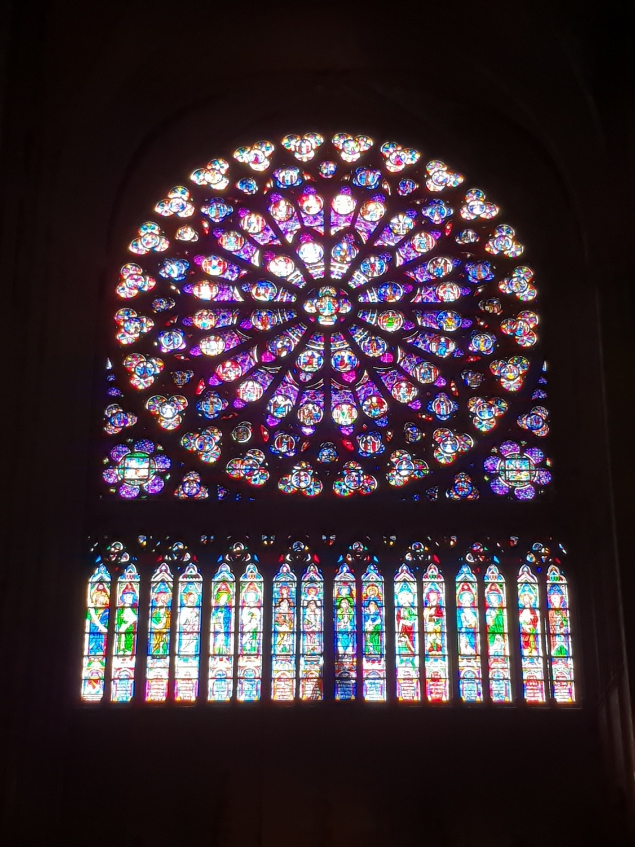
Notes:
This picture is of a stained glass window in Notre Dame in Paris.
God created man, man created this. However as you look into the night sky, you can’t help but go “Wow” God you are so vast and creative.

Slide 7
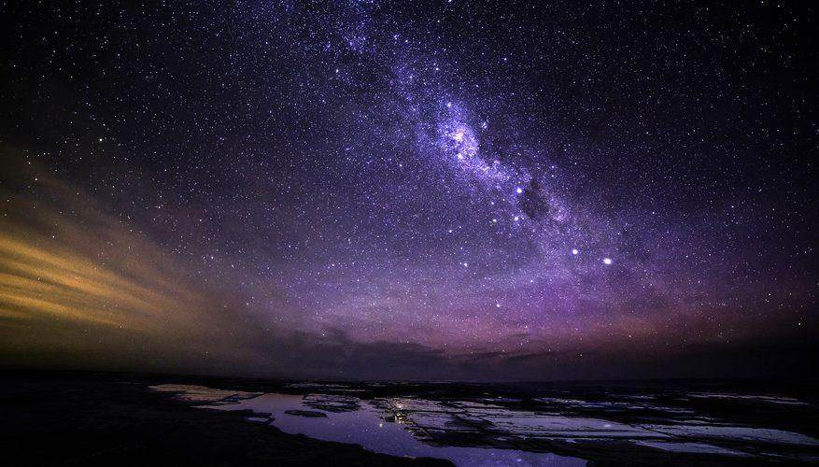

Slide 8
2. God is our Foundation
1 Corinthians 3:11
For no other foundation can anyone lay than that which is laid, which is Jesus Christ.
Notes:
Timely that we went through Derek Prince “Laying the Foundation” this year in our Life Groups.

Slide 9


~
HEAR & DO
HEAR & DO
~
~
FOUNDATION (ROCK) = JESUS CHRIST
Notes:
Matthew 7:24-27
²⁴ “Therefore whoever hears these sayings of Mine, and does them, I will liken him to a wise man who built his house on the rock: ²⁵ and the rain descended, the floods came, and the winds blew and beat on that house; and it did not fall, for it was founded on the rock.
²⁶ “But everyone who hears these sayings of Mine, and does not do them, will be like a foolish man who built his house on the sand:²⁷ and the rain descended, the floods came, and the winds blew and beat on that house; and it fell. And great was its fall.”
If we have this sure foundation, we will be in harmony with Christ and His purpose. Which is to seek first God’s kingdom and His righteousness. Matthew 6:33
³³ But seek first the kingdom of God and His righteousness, and all these things shall be added to you.

Slide 10
2. God is our Foundation
Pillars:
- Primary function is to support
- Synonyms: column, support, backbone, strength
Notes:
Pillars should be set on a solid foundation of stone. Matthew 7:24
²⁴ “Therefore whoever hears these sayings of Mine, and does them, I will liken him to a wise man who built his house on the rock:
A pillar’s treasure will be in Heaven and not what is accomplished in the world. Matthew 6:19-24
¹⁹ “Do not lay up for yourselves treasures on earth, where moth and rust destroy and where thieves break in and steal; ²⁰ but lay up for yourselves treasures in heaven, where neither moth nor rust destroys and where thieves do not break in and steal. ²¹ For where your treasure is, there your heart will be also.

Slide 11
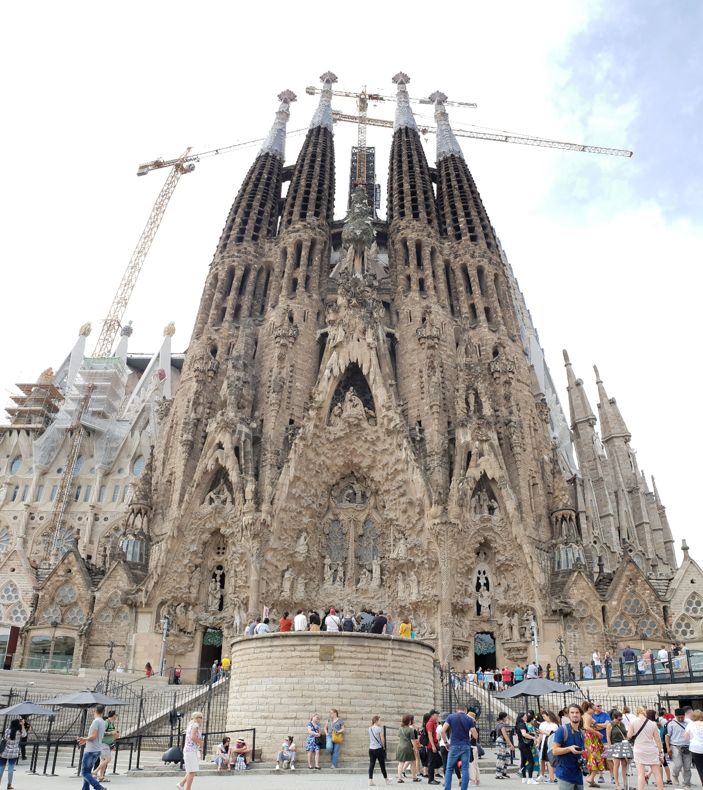
Notes:
Sagrada Familia in Barcelona

Slide 12
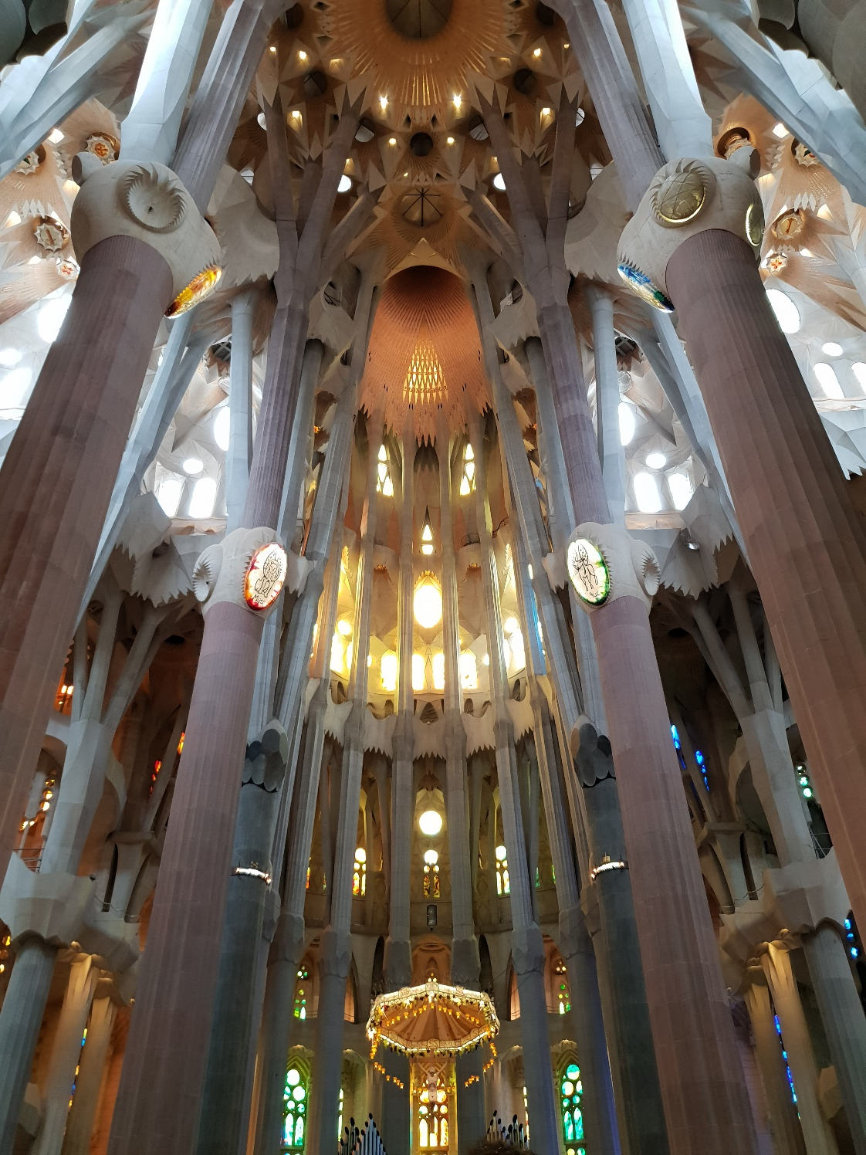
Notes:
Inside of the Sagrada Familia

Slide 13
3. God is a Great Rewarder
Hebrews 11:6
But without faith it is impossible to please Him, for he who comes to God must believe that He is, and that He is a rewarder of those who diligently seek Him.
Notes:
Yes God is a rewarder, but there are some requirements on our part that we need to action:
Believe on who God/Jesus is
Diligently seek Him

Slide 14
3. God is a Great Rewarder
Matthew 7:9-11
Or what man is there among you who, if his son asks for bread, will give him a stone? ¹⁰ Or if he asks for a fish, will he give him a serpent? ¹¹ If you then, being evil, know how to give good gifts to your children, how much more will your Father who is in heaven give good things to those who ask Him!
Notes:
Kinder Surprise from dad
Dino and Amy story

Slide 15

2018 was truly a WOW year, but 2019 will be even better as we build as one family towards our destiny in Christ.

